Slide 1

NFL Database Application
Vishnu Bondalakunta
Charles Zumbaugh
James Chapman
Flickr: Barry Schwartz

Slide 2

Example slides from previous presentations With Kansas State University background
James Chapman
CIS 730 Artificial Intelligence– Term Project
Kansas State University
jachapman@ksu.edu

Slide 3
Overview
Background - Reinforcement Learning
Deep Reinforcement Learning
Experiment Design
Gymnasium
Training - Pong & Breakout
Testing & Evaluation
Results
Discussion
Notes:
I think everybody knows that lithium-ion batteries is a growing technology with a big future. And that batteries have a shelf life.

Slide 4
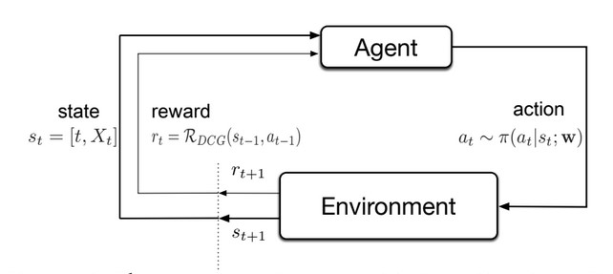
Background - Reinforcement Learning (1 of 4)
“Classic” Reinforcement Learning
Machine learning
Control theory
Markov Decision Process
Mathematical Framework for Dynamics
Probabilistic state-transition
s, a, r, 𝑃
Sutton, R. S., Barto, A. G. (2018 ). Reinforcement Learning: An Introduction. The MIT Press.
$$P\left(s^{′} | s,a\right)=\operatorname{Pr}\left(s_{t}=s^{′} | s_{t−1}=s,a_{t−1}=a\right)$$

